Slide 1
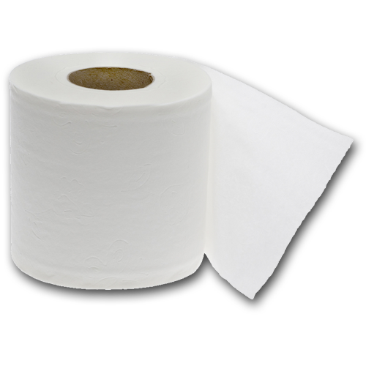
Grab the Teepee
Linda Puzey
Spider-Man Work from Home

Slide 2
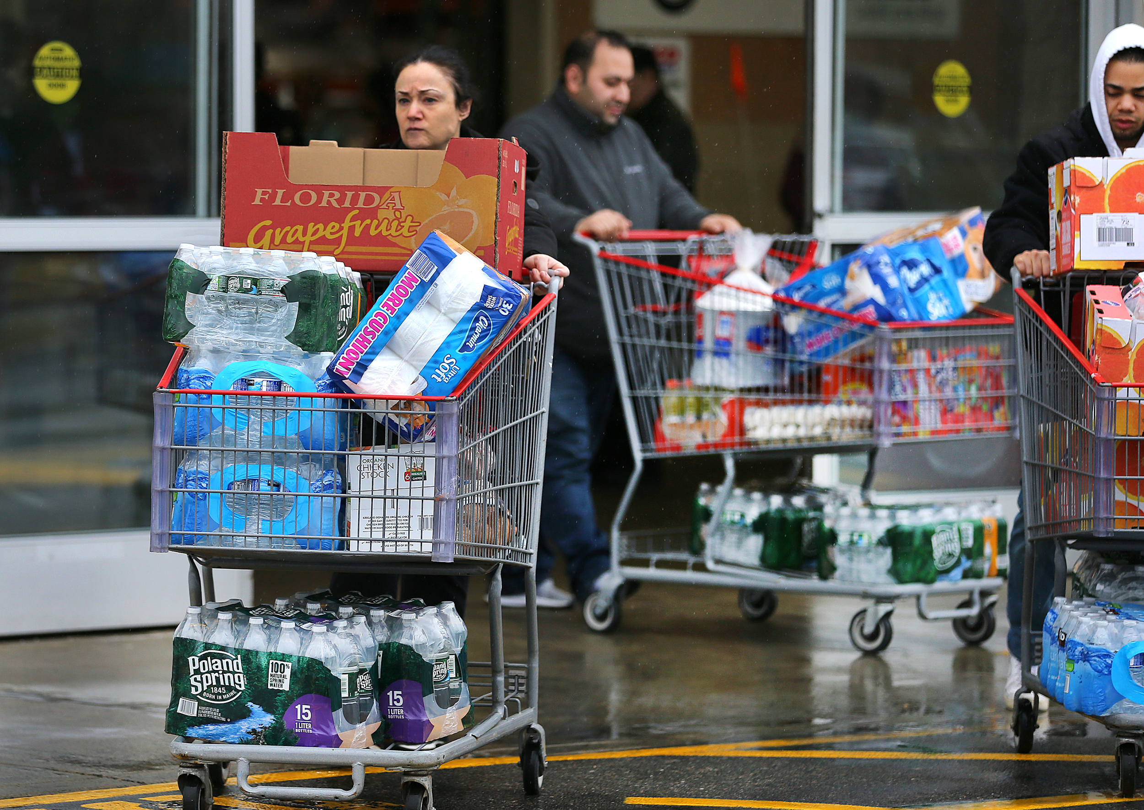
Logline
Corona has hit! Hoard all the toilet paper you can before it’s too late!

Slide 3
Features List
Unending amounts of levels
Levels get progressively harder
Highscore counter
Toilet Paper that appears in someway
Don’t grab anything infected with Corona or you lose a life
3 Lives before you get corona and die

Slide 4
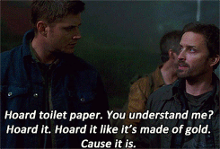
Artist Statement
The experience goal of this game is to poke fun at the absurdity of people hoarding toilet paper during the coronavirus pandemic. It is meant to be fun in the hopes that some people can get a chuckle out of it during this crazy time. It is also supposed to be addictive so that people keep coming back for a higher score.

Slide 5
Play Description (Design 1)
Toilet paper will be falling from the top of the screen to the bottom. Player will control a shopping cart at the bottom row that will catch up to four toilet paper rolls. The player must empty their toilet paper into the car before the cart gets to full. If the card gets too full the player will lose one of three lives. The player will need to fill the car with a certain amount of toilet paper to progress to the next level. The levels will get progressively harder as the player gets further along. Eventually things (coronavirus) will begin to fall that the player should not get in their cart. If they get a bad item in their cart they will lose a life. If they lose all of their lives, the game is over.

Slide 6
Play Description (Design 2)
Toilet paper will be appearing and the player has to click on as many toilet paper rolls as they can before the level timer runs out. Kinda like a whack a mole style game. There is a goal that you must reach or you will lose the level. Once the player hits level 5 the corona will be more deadlier and you have to watch out. At this point you will get 3 lives and if you click on any toilet paper roll that is infected with corona, then you will lose a life. If you lose all your lives you will have to start the game over. The levels will get progressively harder as the player gets further along.

Slide 7
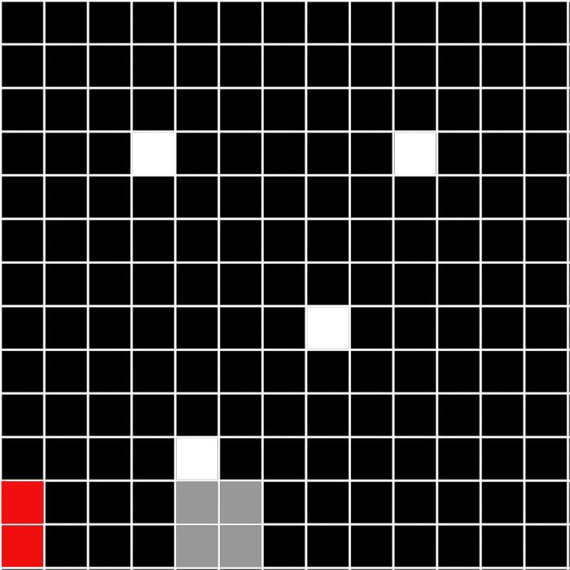
Game Board Mockup (Design 1)
White is the falling toilet paper
Grey block is the shopping cart
Allow the toilet paper to fall into the shopping cart
Move shopping cart left and right by sliding mouse
Shopping cart can only hold 4 toilet papers at once
Click next to the red blox (car) to empty out of cart

Slide 8
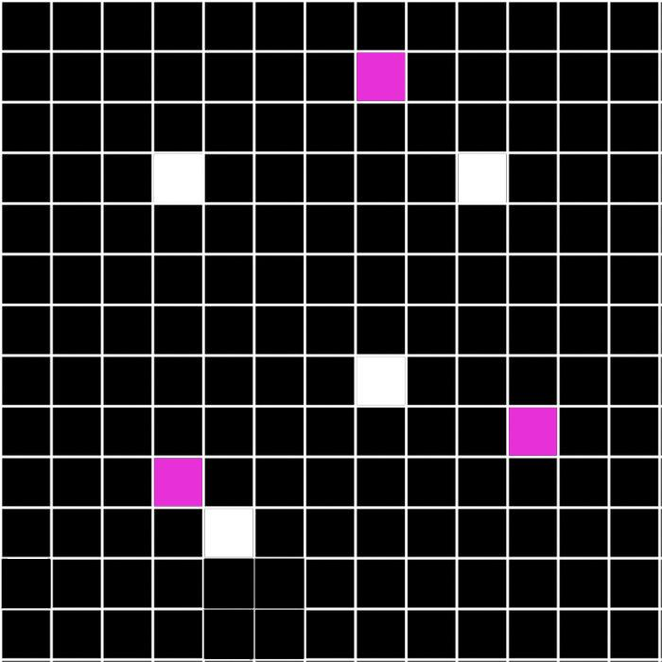
Game Board Mockup (Design 2)
White is the toilet paper you must click on before it fades away
Chorona is the purple that you don’t want to click on or you lose a life

Slide 9
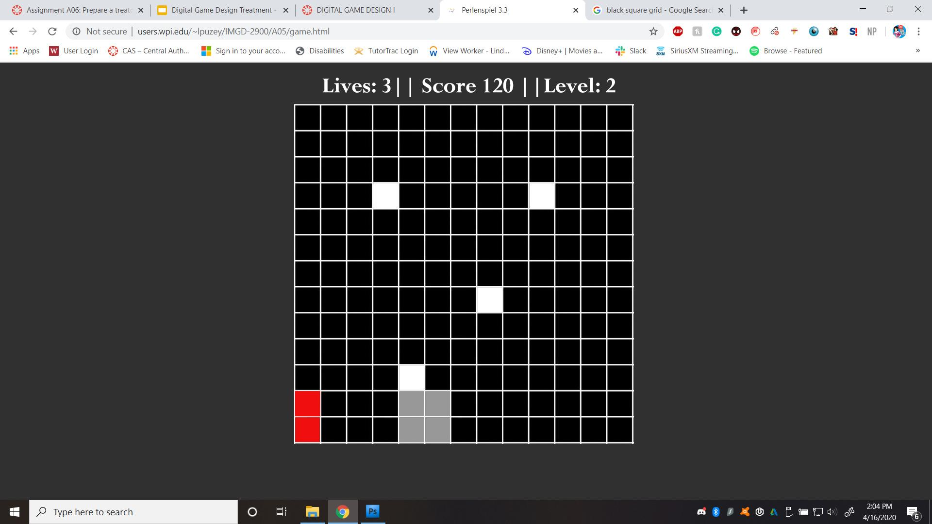
Website Mockup

